Slide 1
How Good a Witness Are You?
On the next slide you will study the picture of the scene of a crime for up to 3 minutes. Once you are done, we will see how good a witness you were!

Slide 2
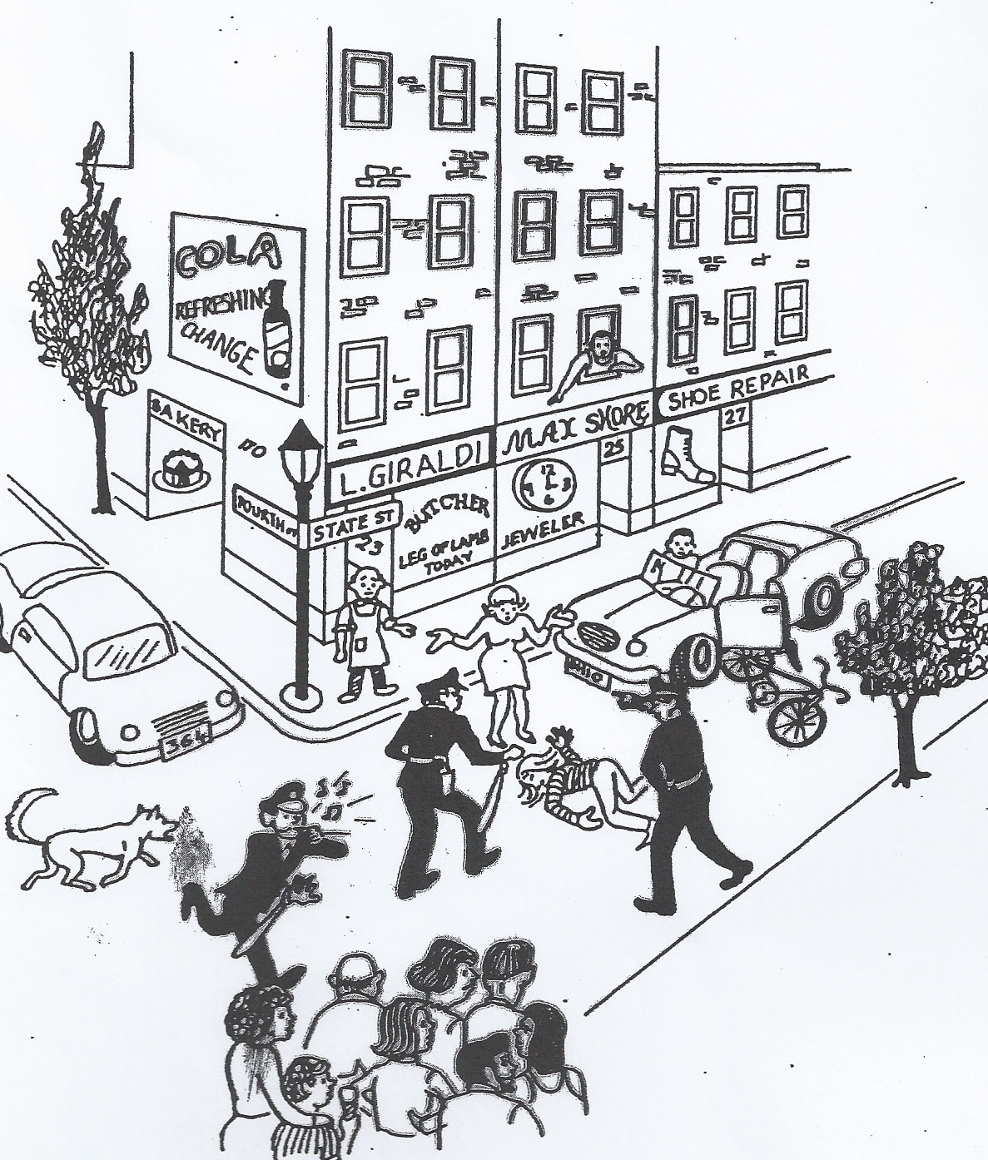

Slide 3
Using your memory only….
On what floor was someone looking out the window?
2
On what street was the Bakery Shop?
Fourth
What time of day did the accident take place?
3 pm
Was the person who was hit a male?
No
Was there a traffic light on the corner?
No

Slide 4
Continued…
What was the license number of the parked car?
364
Was the driver a female?
Yes
Which storekeeper was standing on the street?
Butcher
How many policemen were at the scene?
3
Were there more than 10 people in the crowd?
No, 8
Was the butcher’s first name Max?
No

Slide 5
Were there any children in the crowd?
1
From what state was the car that hit the bicycle?
Ohio
Was it a 4-door car?
No, 2 door
How many trees were in the picture?
2
Were there any animals on the street?
Dog
Was the butcher’s address 23 State St?
Yes

Slide 6
Was the ad on the wall for cigarettes?
No, Cola
Was the weather mild?
Yes
Was the driver of the car alone?
No
Was there a police phone at the corner?
no

