Slide 1
Aim: How are fingerprints classified?
Bellwork: Hand in HW
Article & Ques – Famous Cases of Fingerprinting
Announcements:
Exam next Tuesday 10/29
Will cover the first 3 units

Slide 2
Classifying Fingerprints

Slide 3
How to Roll Fingerprints
Video - How to Roll Fingerprints
TIPS:
1. Begin with RIGHT hand, start with thumb
2. Roll thumbs TOWARDS your body
3. Roll fingers AWAY from your body

Slide 4
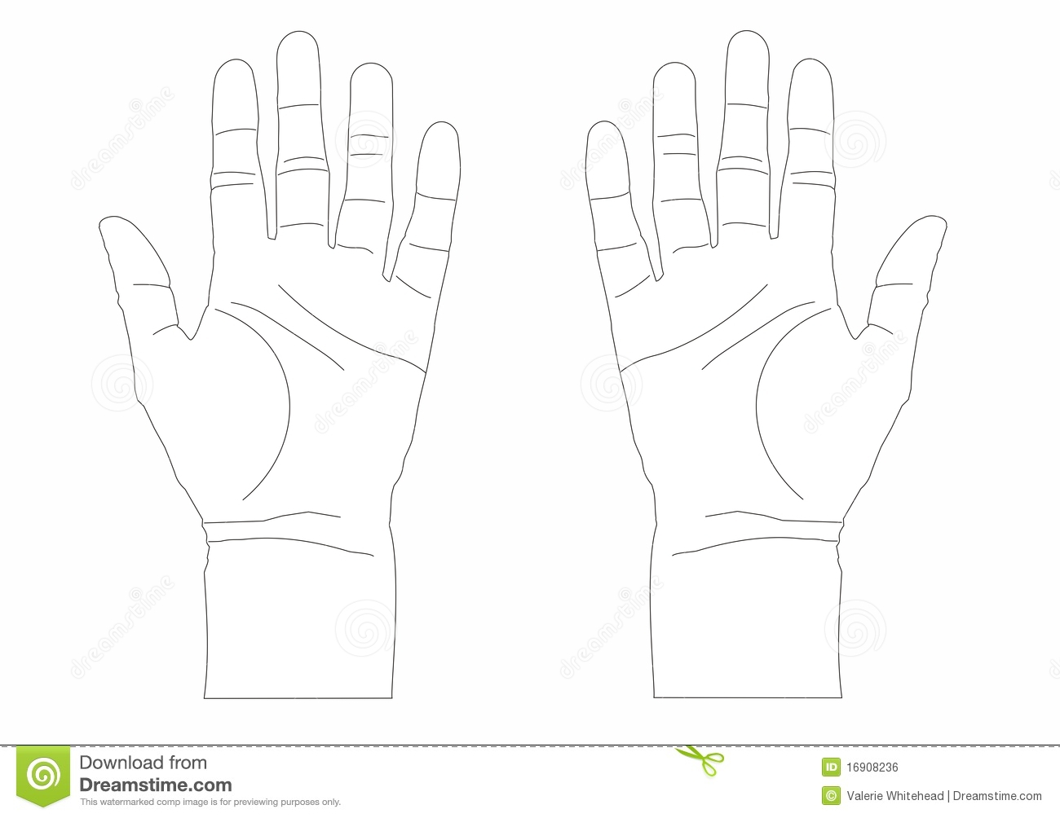
Green = point value if have WHORLS
2
8
2
8
16
1
8
3
7
9
1
4
4
2
10
5
4
16
6
1
Black = Finger Number

Slide 5
Primary Classification of Fingerprints
Is expressed as a fraction
Denominator (bottom number) is the sum of the value of ODD numbered fingers with whorls + 1
Numerator (top number) is the sum of the value of EVEN numbered fingers with whorls + 1

Slide 6
Primary Classification of Fingerprints
EVEN numbered fingers with whorls values + 1
Odd numbered fingers with whorls values + 1

