Slide 1
How can we determine the shape of a molecule?
Do Now:
Name the following compound:
Na₂SO₄
Is this compound ionic or covalent?
Does it contain ionic or covalent bonds?

Slide 2
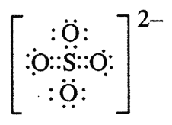
Na₂SO₄
Is an ionic compound (contains ions 2Na⁺ and SO₄⁻²)
It contains both ionic and covalent bonds
Ionic bonds between the ions (2Na⁺ gave electrons to SO₄⁻² )
Covalent bonds within SO₄⁻².
The polyatomic ions are mostly made of nonmetals and are therefore held together by covalent bonds.
[Na]⁺
[Na]⁺

Slide 3
Draw dot diagrams for:
HBr
CO₂
O₂
H₂O
NH₃
CH₄
CF₂O

Slide 4
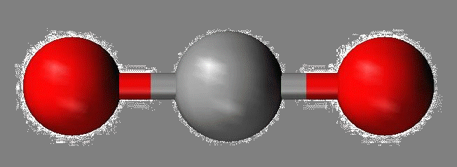
Linear
Shaped like a line
Any 2-atom molecule
Any compound where the center atom is bonded to only 2 other atoms and does not have any lone pairs
H-Br
O=O
O=C=O

Slide 5
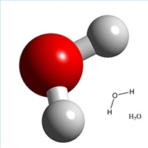
Bent (Angular)
Any molecule where the center atom is bonded to 2 other atoms and has 2 lone pairs
H O
H

Slide 6
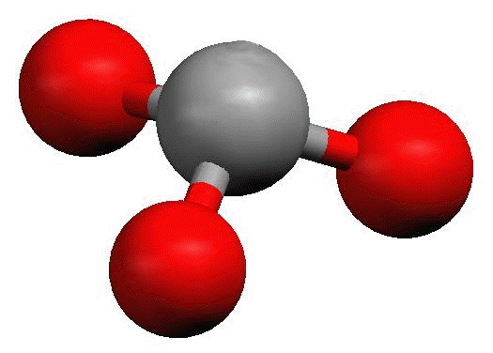
Pyramidal
Any molecule where the center atom is bonded to 3 other atoms and has 1 lone pair
H N H
H

Slide 7
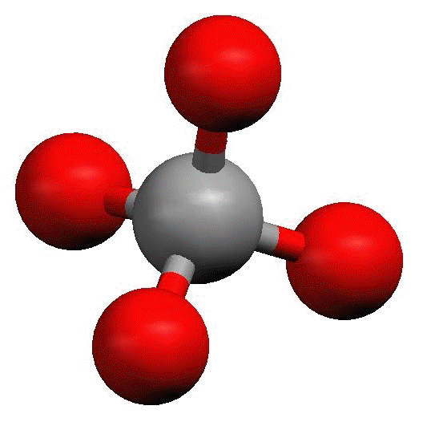
Tetrahedral
Any molecule where the center atom is bonded to 4 other atoms and has no lone pairs
H
H C H
H

Slide 8
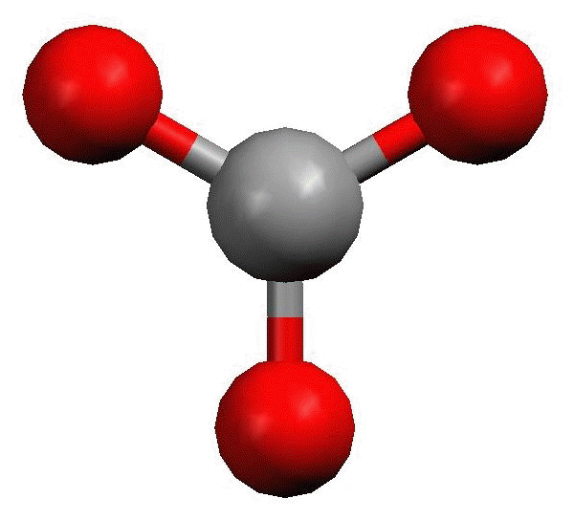
Trigonal Planar
Any molecule where the center atom is bonded to 3 other atoms and has no lone pairs
F
F
C
O

Slide 9
Shape | Bonds on Center atom | Lone pairs on center atom
Linear | 2 | 0
Bent | 2 | 2
Pyramidal | 3 | 1
Tetrahedral | 4 | 0
Trigonal Planar | 3 | 0

