Slide 1
BEND and _____?
Let’s talk about POLARITY
http://www.youtube.com/watch?v=MqUQQPz9vFo

Slide 2
Molecular Polarity
Molecular polarity is a result of asymmetrical distribution of charge over the molecule
To determine molecular polarity look at the shape
REMEMBER
SNAP
Symmetrical Nonpolar Asymmetrical Polar

Slide 3
Linear
Asymmetrical distribution of charge = polar molecule
Symmetrical distribution of charge = nonpolar molecule
δ+
H-Br
δ-
δ+
H – C N
δ-
O=O
O=C=O

Slide 4
Bent
Asymmetrical distribution of charge = polar molecule
δ-
H O
H
δ+

Slide 5
Pyramidal
δ-
Asymmetrical distribution of charge = polar molecule
H N H
H
δ+

Slide 6
Tetrahedral
δ+
H
Cl C Cl
H
Asymmetrical distribution of charge = polar molecule
Symmetrical distribution of charge = nonpolar molecule
δ-
H
H C H
H

Slide 7
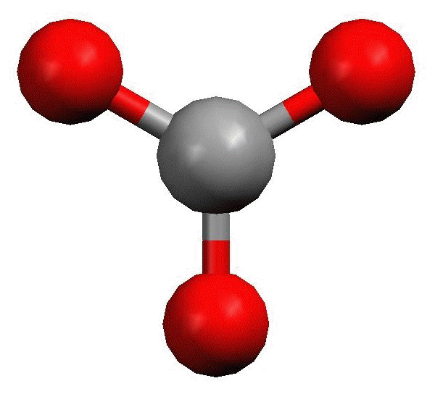
Trigonal Planar
Asymmetrical distribution of charge = polar molecule
Symmetrical distribution of charge = nonpolar molecule

Slide 8
Shape | Bonds on Center atom | Lone pairs on center atom | Polarity
Linear | 2 | 0 | Polar or Nonpolar
Bent | 2 | 2 | Polar
Pyramidal | 3 | 1 | Polar
Tetrahedral | 4 | 0 | Polar or Nonpolar
Trigonal Planar | 3 | 0 | Polar or Nonpolar

