Slide 1
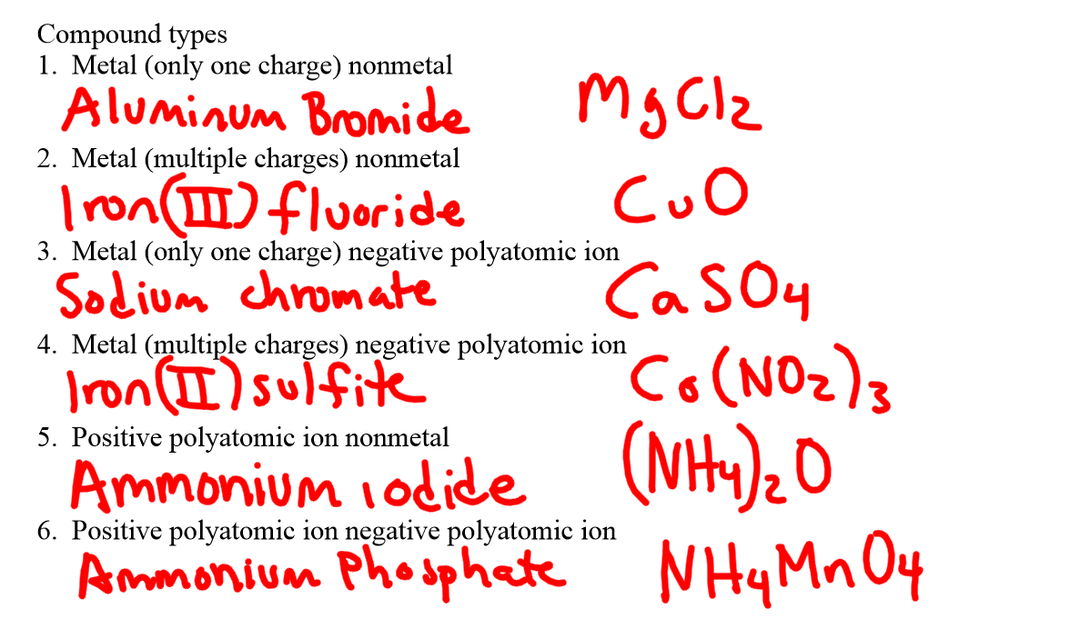
Convert the name into a formula and the formula into a name. Se the answers on the next 2 slides

Slide 2
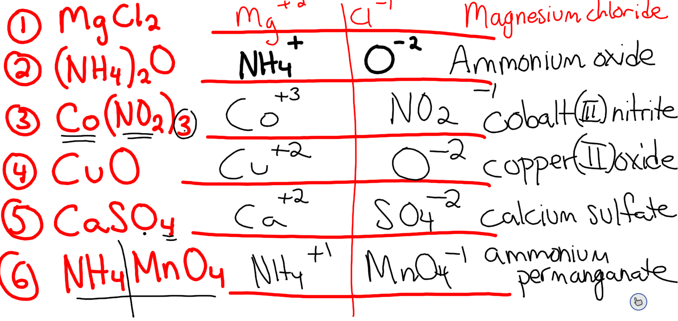

Slide 3
