Slide 1
How Good a Witness Are You?
On the next slide you will study the picture of the scene of a crime for up to 3 minutes. Once you are done, we will see how good a witness you were!

Slide 2
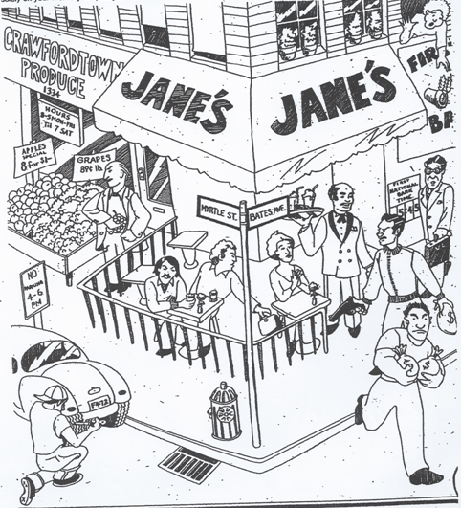

Slide 3
Using your memory only….
What time was it by the bank clock?
5:45 pm
What day of the week was it?
Saturday
What was the name of the outdoor café?
Jane’s
On what street was its entrance?
Bates Ave.
How many thieves were staging the holdup?
2

Slide 4
Continued…
Were they armed?
One was
How many bags of loot were they carrying?
3
Was the thief in the street wearing a hat?
No
How many people, besides you and the holdup men, were at the scene of the robbery?
8
What were the initials of the man in the business suit?
V.L.

Slide 5
What immediate danger was he in?
Flowerpot
Was the onlooker from the second floor a man or a woman?
Debatable.
What store was next door to the café?
Crawfordtown produce
On what street was its entrace?
Myrtle street.
What was the shopper stealing?
Grapes
What was the license number of the car parked in front of the store?
F472

Slide 6
Why was it illegally parked?
No parking 4 – 6 pm
What part of the car was being vandalized?
Rear left tire
What offence was being perpetrated against the lady diner?
Bag stolen
Was there a police phone at the corner?
no

Slide 8
Forensics
Derived from the “forums” of ancient Rome
Applies to anything that relates to law
Forensic science is also known as criminalistics and describes the application of scientific principals to the law.
Example:
Pathology – the study of the origin or nature of diseases
Forensic Pathology – the study of the origin or nature of diseases and how it relates to solving a crime (i.e. cause of death etc.)

Slide 9
Scientific applications to legal issues
Pathology: the study of diseases (pathogens)
Toxicology: the study of drugs and poisons
Serology: the study of blood
Fingerprinting: takes the place of unreliable eyewitnesses
DNA/Blood typing: matching suspect to crime scene
Physics: ballistic trajectory/crime scene reconstruction
Photography: clear representation of a crime scene
Microscopes: analysis of small details (fabrics, hair, paper)

Slide 10
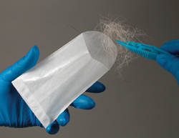
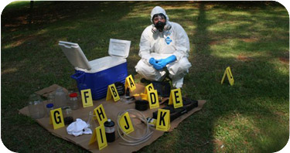
Identification, collection, documenting and storing of evidence:
Evidence Collection Unit (CSI): collect and preserve evidence and transport it to the lab. Could be a police officer or CSI professional. Collect prints, hair, fiber and other trace evidence.

Slide 11
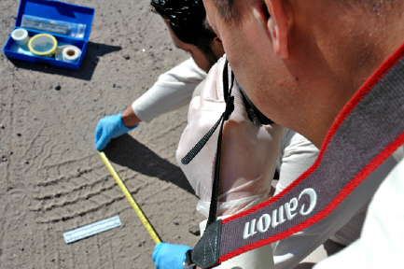
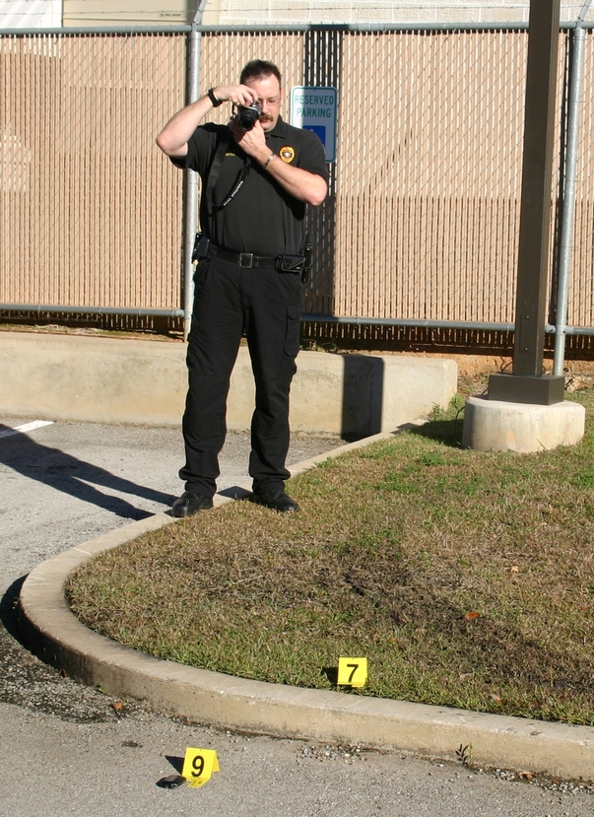
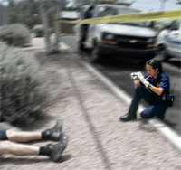
Photography Unit: take pictures of crime scene and body that could be crucial to courtroom presentations. THIS MUST BE DONE BEFORE COLLECTING THE EVIDENCE!

Slide 12
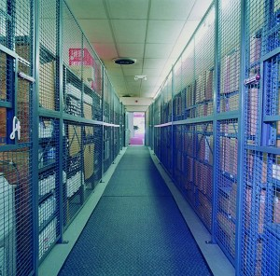
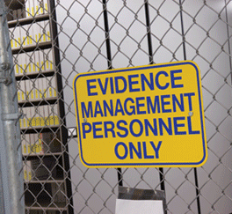
Evidence Storage:
Evidence gets stored in a locked room with restricted access, sometimes kept for decades. The chain of custody needs to be unbroken so evidence is not compromised.

Slide 13
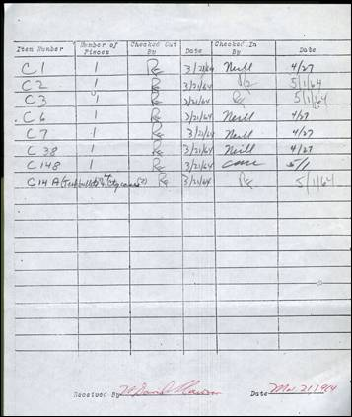
Chain of Custody
refers to the chronological documentation or paper trail, showing the seizure, custody, control, transfer, analysis, and disposition of evidence, physical or electronic. This is to ensure evidence was not tampered with during a trial.

Slide 14
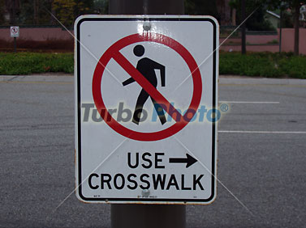
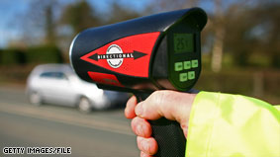
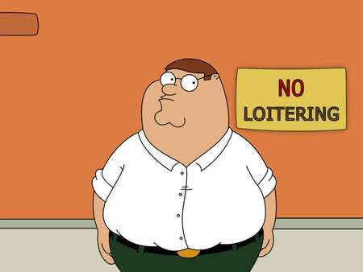
Infraction
A minor violation of the law that is punishable only by a fine

Slide 15
Misdemeanor
A crime, less serious than a felony, punishable by no more than one year in jail. Common examples include petty theft (petty larceny) which is theft of merchandise up to a certain amount. Petty theft for NY is any theft up to $1000.00. For Florida it is any theft up to $300.00!

Slide 16
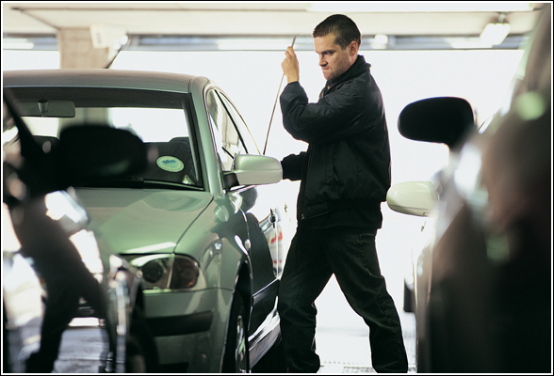
Felony
An offense, such as murder or burglary, of a graver character than those called misdemeanors, especially those commonly punished in the U.S. by imprisonment for more than a year. Grand theft (grand larceny) for NY is any theft over $1000.00

Slide 17
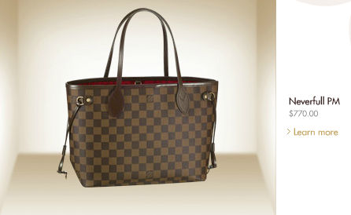
Example
Sara and Clara went to the mall and made the bad decision to steal the bags shown on the right. Sara stole the bag shown on top for $1350.00. Clara stole the bag shown on the bottom for $770.00. Even though the bags look very similar, the girls’ fate is very different!

Slide 18
Different fates…
Sara was charged with a ________________ because she committed ________________. She was arrested and brought to ______________ for a term of ________________
Clara was charged with a ________________ because she committed ________________. She was arrested and brought to ______________ for a term of ________________
FELONY
MISDEMEANOR
GRAND LARCENY
PETTY LARCENY
STATE PRISON
COUNTY JAIL
MORE THAN ONE YEAR
LESS THAN ONE YEAR

