Slide 1
AIM: How can anthropology aid in solving crimes?
Bellwork: What do you already know about anthropology?

Slide 2
Forensic Anthropology
a type of applied anthropology that specializes in the changes and variations in the human skeleton for the purpose of legal inquiry

Slide 3
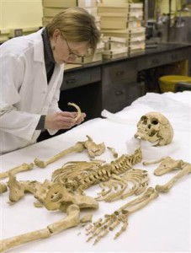
A forensic anthropologist may…
provide basic identification information for skeletons or badly decomposed remains.
be able to determine:
An age range
Sex
Race
Approximate height
Cause of death, disease, or anomaly

Slide 4
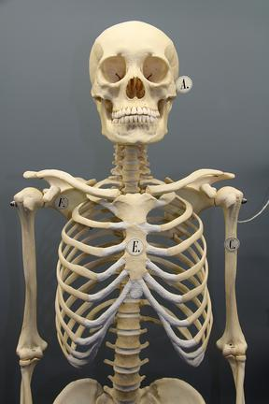
Osteology (osteon=bone)
Study of bones
206 bones in an adult human
Function of bones:
Provides structure and rigidity
Protects soft tissue and organs
Serves as an attachment for muscles
Produces blood cells
Serves as a storage area for minerals
Can detoxify the body by removing heavy metals and other foreign elements from the blood

Slide 5
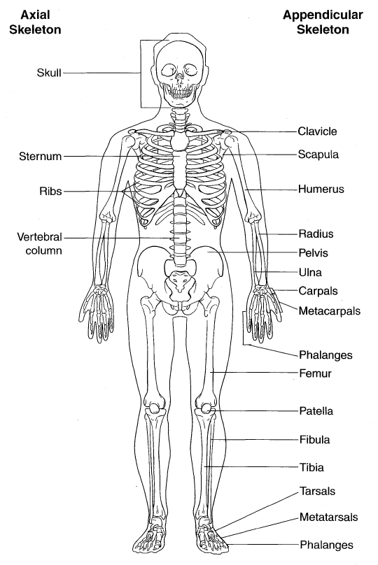

Slide 6
Do you recognize any of these bones?
cranium
Bones of the Human Skeleton
skull
mandible
pectoral girdle
clavicle
scapula
ribs
sternum
humerus
vertebral column
vertebrae
ilium
pelvic girdle
radius
ulna
carpals
femur
metacarpals
phalanges
patella
tibia
fibula
tarsals
metatarsals
phalanges

Slide 8
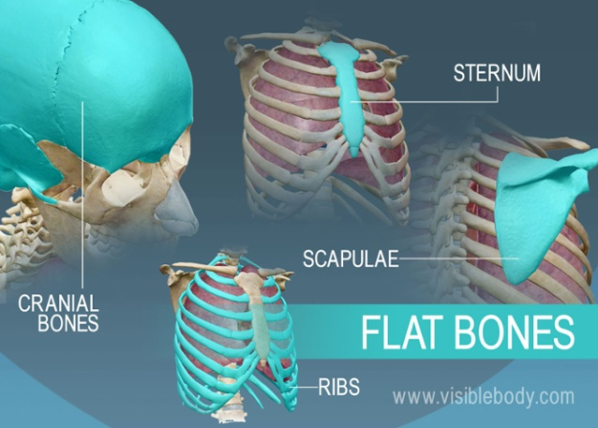

Slide 12
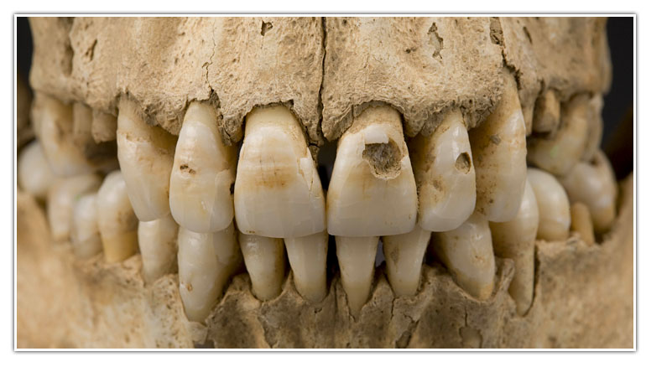
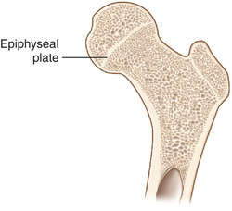
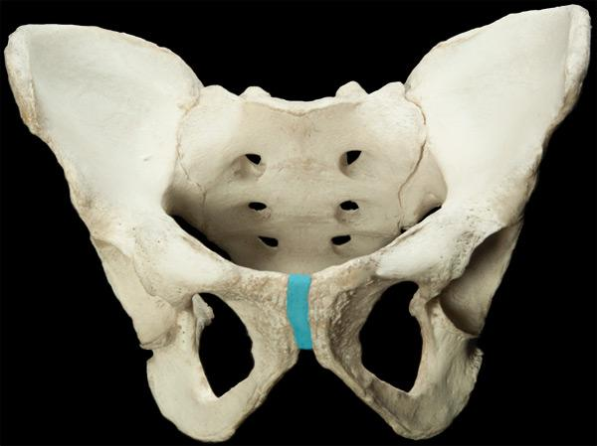
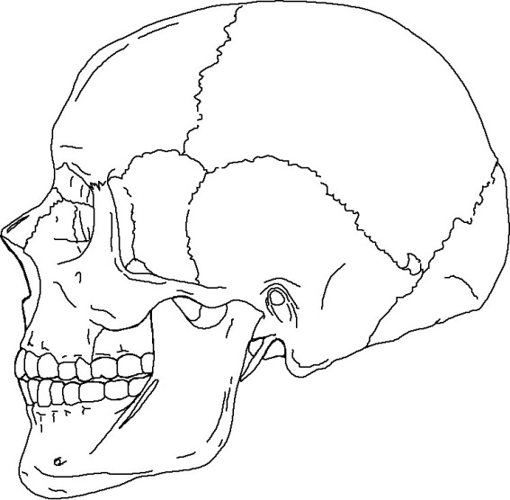
Age Determination
Most accurate estimations come from:
Teeth
Epiphyses (growth plates)
Pubic symphysis
Cranial sutures: appear as distinct lines in youth and gradually close from the inside out.
Investigators always use an age range because of the variation in people and how they age. The investigator does not want to eliminate any possibilities for identification.

Slide 13
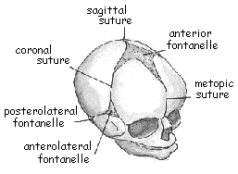

Slide 14
Age Determination Using Cranial Sutures
Sagittal suture completely closed
Males—26 or older
Female—29 or older
Sagittal suture is completely open
Male—less than 32
Female—less than 35
Complete closure of all three major sutures
Male—over 35
Female—over 50
Sagittal suture
Lambdoid suture
Coronal suture

Slide 15
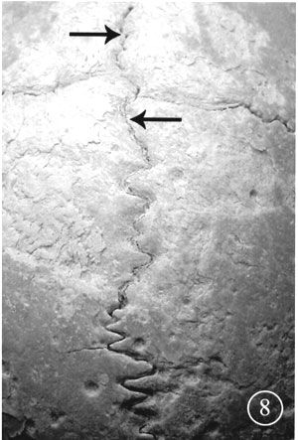
Partial Fusion of Sutures
Sutures have begun to fuse (top)
Sutures not yet fused (bottom)

Slide 16
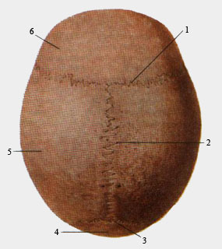
Frontal bone
FRONT OF SKULL
Coronal suture
Sagittal suture
Parietal bone
Occipital bone
Lambdoid suture

Slide 17
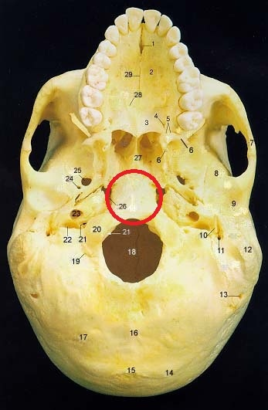
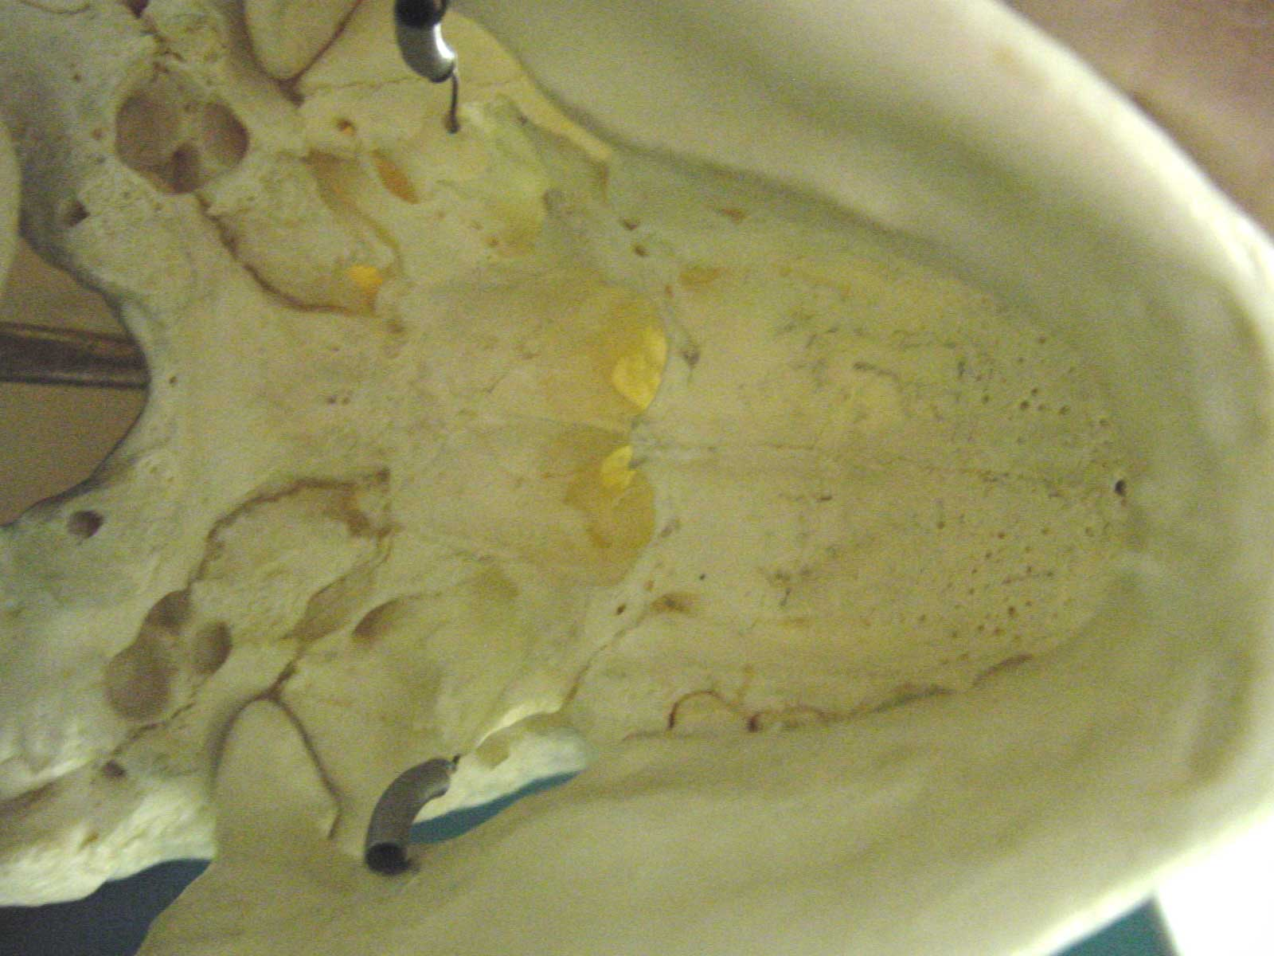
Age Determination Using Basilar Suture
Technically known as the synchondrosis spheno-occipitalis, closes in females as young as 14 and in males as young as 16. If the suture is open, the individual is generally considered 18 or younger.

Slide 18
Gender Differences in Bones
1. The Pelvis
The pelvis of the female is wider. Males have a narrow subpubic angle (A) and a narrow pubic body (B).

Slide 19
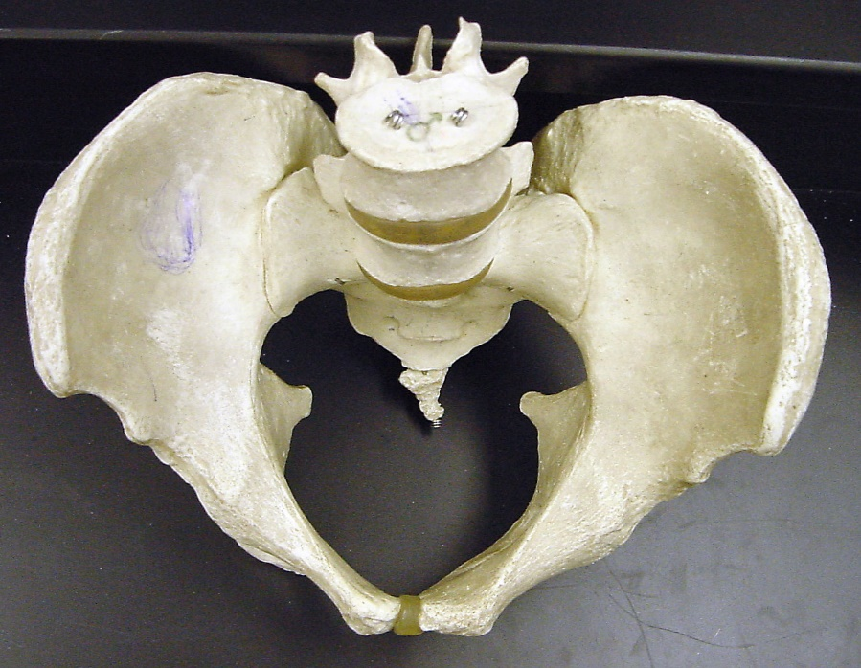
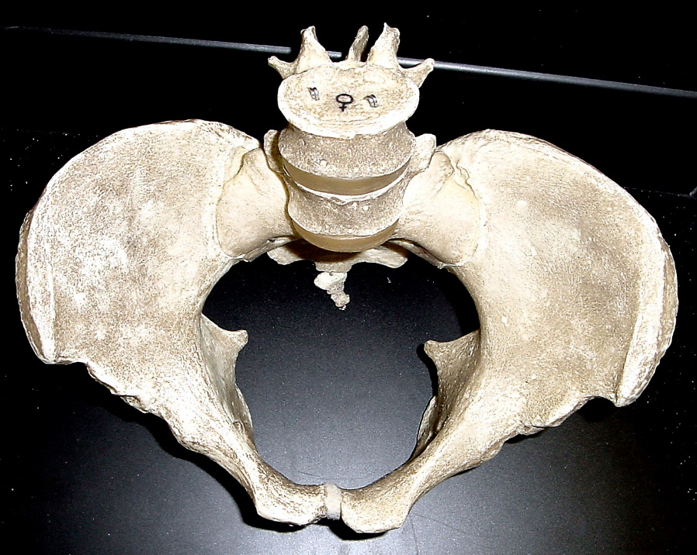
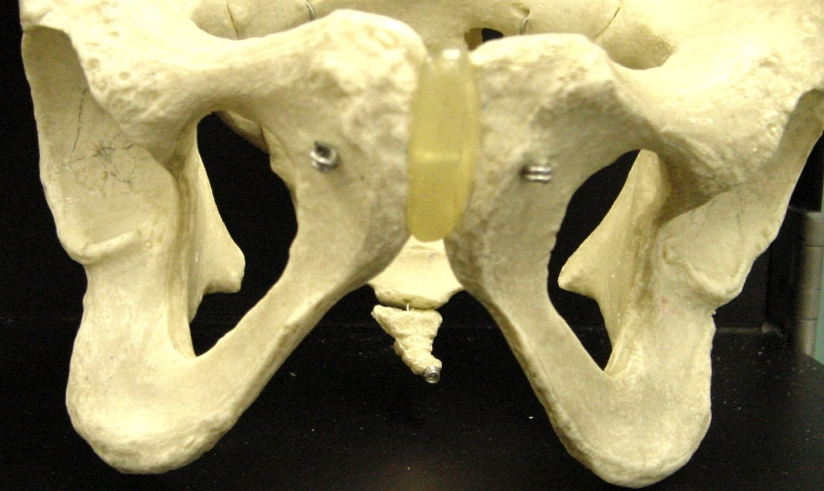
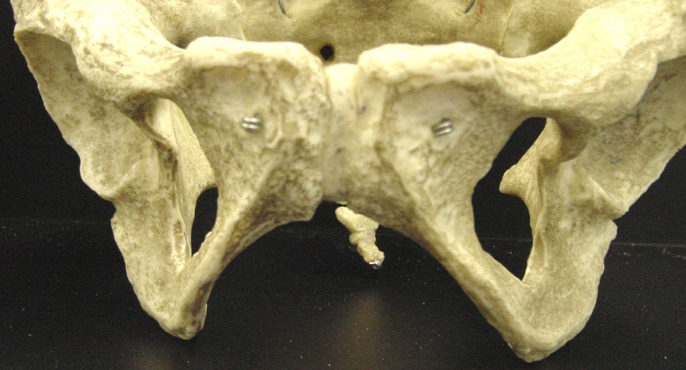
Male
Female
Sub Pubic Angle

Slide 20
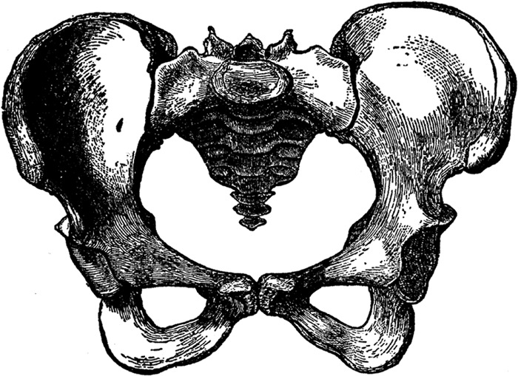
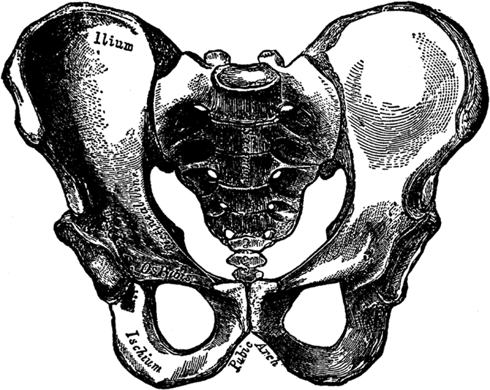
FEMALE
MALE

Slide 21
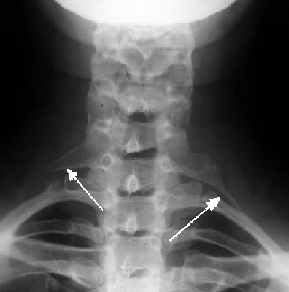
2. The Rib Cage
The ribcage and shoulders of males are generally wider and larger than that of females.
In addition, 1 in 200 people have an extra rib called a cervical rib (more common in males)

Slide 22
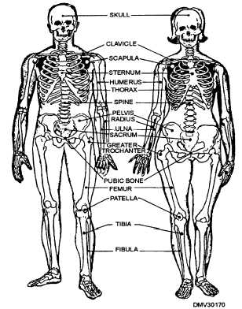

Slide 23
3. Fingers
The male index finger is sometimes shorter than the third finger (ring finger).
In females, the first finger is sometimes longer than the third finger. (This is not often used as an indicator of gender as there are many exceptions.)
Is this a male or female hand
according to the above rule?
?

Slide 24
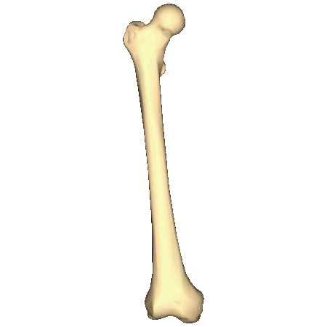
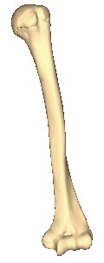
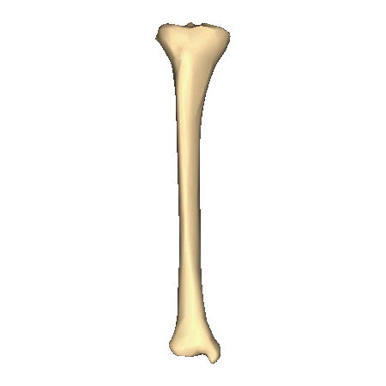
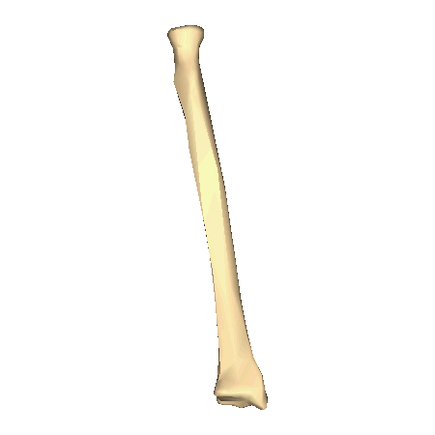
Estimation of Height
The height of a person can be calculated by using the length of certain long bones, including the femur, tibia, humerus, and radius. Below are the equations to determine average measurements for both male and female. (All measurements are in centimeters)
Male Female
femur x 2.23 + 69.08 femur x 2.21 +61.41
tibia x 2.39 + 81.68 tibia x 2.53 + 72.57
humerus x 2.97 + 73.57 humerus x 3.14 + 64.97
radius x 3.65 + 80.40 radius x 3.87 + 73.50

Slide 25
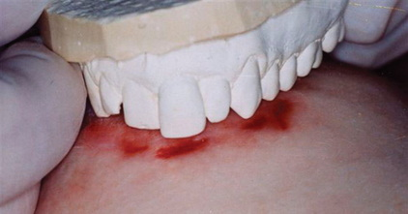
Odontology
Teeth are the hardest material in the body
Unusual features can help to individualize a suspect:
number and types of teeth/ fillings
the spacing of the teeth
special dental work (bridges, false teeth, root canals)

Slide 26
Facial Restoration
After determining the sex, age, and race of an individual, facial features can be built upon a skull to assist in identification. Erasers are used to make tissue depths at various points on the skull. Clay is used to build around these markers and facial features are molded.

Slide 27
Steps in Facial Reconstruction
With a skull:
Establish age, sex and race
Plot landmarks for tissue thickness
Plot origin and insertion points for muscles
Plot landmarks for facial features
Select a dataset and mount markers for tissue thickness
Mount the eyes
Model muscles on skull
Add fatty tissue around eyes and lacrimal (tear) glands
Add eyelids
Add the nose
Add the parotid (salivary) gland
Add the ears
Cover all with layers of skin
Detail the face
Video - Forensic Facial Reconstruction (5 min)

Slide 28
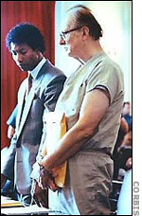
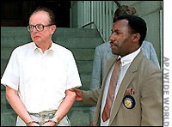
John List killed his entire family, moved to a new town and assumed a new identity. Seventeen years later, Frank Bender reconstructed what he believed List would look like. It was shown on America’s Most Wanted, and he was turned in by the viewers almost immediately. . . looking very much like the reconstruction.
Video - Forensic Sculptor Frank Bender (3 min)

