Slide 1
AIM: What is DNA and how is it useful in Forensics?
Hand in your Homework: Packet – DNA the double helix (coloring & questions)

Slide 2
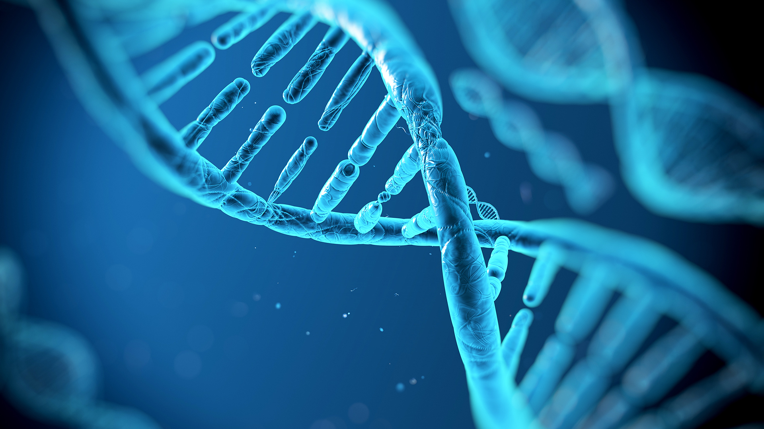
DNA

Slide 3
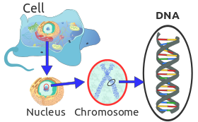
What is DNA?
The genetic material in the chromosome is DNA
DNA stands for Deoxyribonucleic Acid
DNA is found in almost all living cells

Slide 4
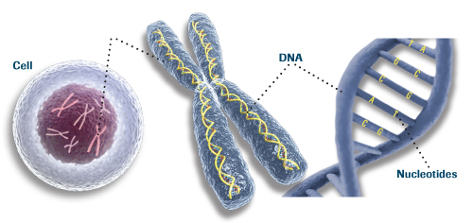
What is DNA? (cont.)
DNA is a long molecule that is made up of many small subunits called nucleotides
DNA is found in the nucleus of the cell

Slide 5
What is DNA? (cont.)
Every human cell has 46 chromosomes → approx 25,000 genes → 3 BILLION base pairs.
A gene is the unit of heredity that instructs the body to make proteins that determine our characteristics. The base pairs are part of the DNA molecule.
In 1868, DNA was discovered and in the 1950s, Watson & Crick announced that DNA had a double helix structure.

Slide 6
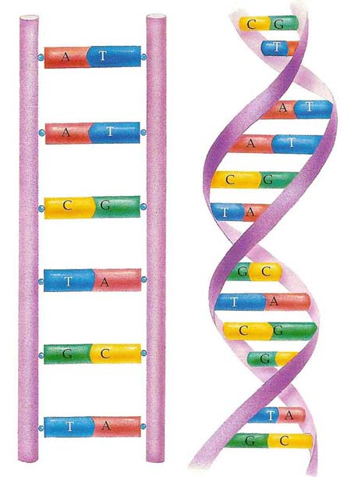
What makes up DNA?
The double helix, which resembles a twisted ladder or a spiral staircase, can be stretched out to look like a ladder. The ladder consists of many nucleotides.

Slide 7
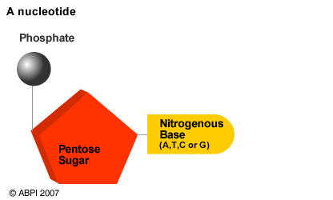
What makes up DNA? (Cont.)
Nucleotides are made up of three basic parts:
Five carbon sugar called deoxyribose
Phosphate group
Nitrogenous base

Slide 8
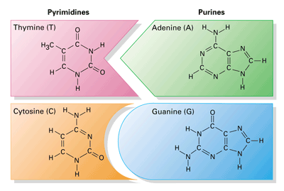
Nucleotide STRUCTURE
Each leg of the ladder consists of an alternating sugar and phosphate unit. The rungs of the ladder are made of pairs of nitrogenous bases that are bonded together.
There are four different nitrogenous bases in a DNA molecule:
Adenine (A)
Guanine (G)
Cytosine (C)
Thymine (T)

Slide 9
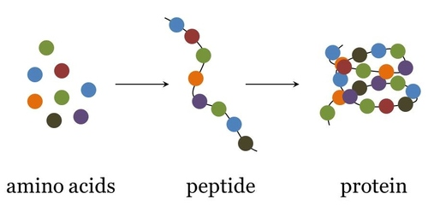
NUCLEOTIDE STRUCTURE (CONT.)
The order of the bases in the DNA molecule provide instructions used to build amino acids and link them together into proteins.

Slide 10
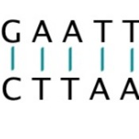
NUCLEOTIDE STRUCTURE (CONT.)
Base pairing rule:
One nitrogenous base will only join with a certain other nitrogenous base.
Example:
Adenine can only join with thymine (A-T)
Thymine can only join with adenine (T-A)
Cytosine can only join with guanine (C-G)
Guanine can only join with Cytosine (G-C)

Slide 11
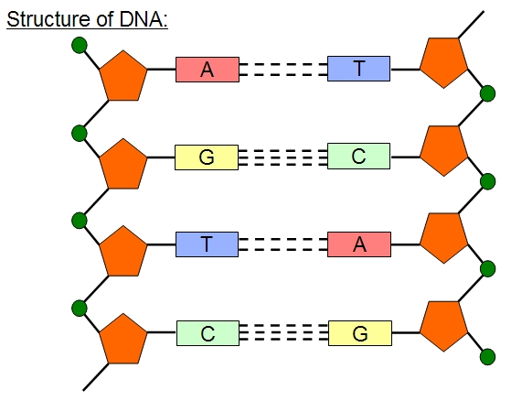
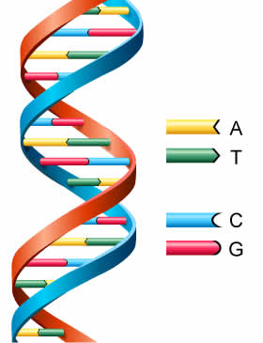
DNA Models

Slide 12
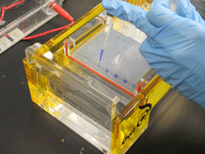
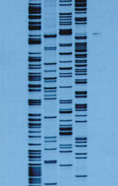
How is DNA used in Forensics?
DNA Fingerprinting
The DNA of all people is basically the same except there are certain areas of the DNA base pair sequence which are repetitive. These sections can be separated by electrophoresis to create an individual specific DNA banding pattern, which is called DNA fingerprinting. The DNA bands are extremely individualized.

Slide 13
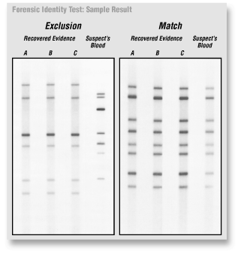
DNA Fingerprinting / Profiling

Slide 14
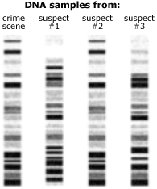
DNA Fingerprinting / Profiling

Slide 15
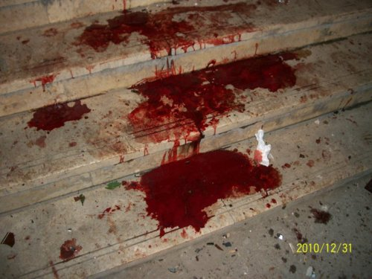
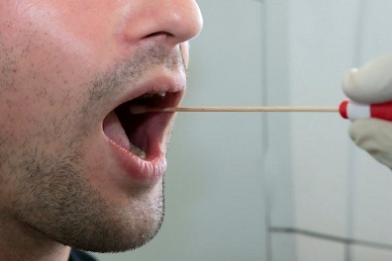
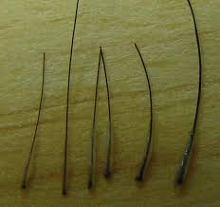
DNA Fingerprinting / Profiling
Today DNA fingerprinting is routinely used to test samples of blood, hair root, saliva, semen, and other bodily fluids.

Slide 16
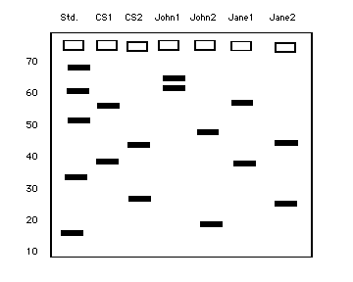
DNA Fingerprinting / Profiling
Std = Standard (control)
CS1 = Crime Scene Sample #1
CS2 = Crime Scene Sample #2
2 parts of John Smith’s genome
2 parts of Jane Jones’ genome
Who is associated with the crime scene?

Slide 17
DNA Fingerprinting / Profiling
DNA fingerprinting can also be used to determine familial relationships as half a person’s genome comes from each parent.

Slide 18
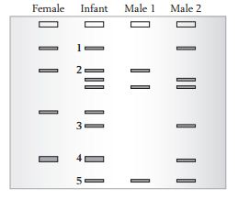
Notes:
In this hypothetical paternity case, four autoradiographs show DNA "fingerprints" taken from three individuals: a mother, her child, and the child's alleged father. Each autoradiograph compares equivalent DNA segments from the three individuals. The two dark bands in each column represent one individual's DNA segments -- one inherited from that individual's biological mother and the other from the biological father. These segments differ in length from person to person; for this reason they are used as genetic markers. Here, each length is designated by a letter, A through O. The two letters associated with each segment indicate the individual's genotype.
Instructions Under each column in the autoradiograph, write the letters associated with each individual's genotype. For example, the genotype of the mother in the first column is A/D. Then, circle the letter in the child's genotype that represents the gene inherited from the mother.
Which "letters" must the child have inherited from its father?
Based on this information, what evidence suggests that the alleged father could be biologically related to the child?

Slide 19
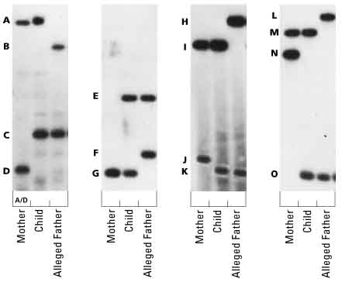
Notes:
In this hypothetical paternity case, four autoradiographs show DNA "fingerprints" taken from three individuals: a mother, her child, and the child's alleged father. Each autoradiograph compares equivalent DNA segments from the three individuals. The two dark bands in each column represent one individual's DNA segments -- one inherited from that individual's biological mother and the other from the biological father. These segments differ in length from person to person; for this reason they are used as genetic markers. Here, each length is designated by a letter, A through O. The two letters associated with each segment indicate the individual's genotype.
Instructions Under each column in the autoradiograph, write the letters associated with each individual's genotype. For example, the genotype of the mother in the first column is A/D. Then, circle the letter in the child's genotype that represents the gene inherited from the mother.
Which "letters" must the child have inherited from its father?
Based on this information, what evidence suggests that the alleged father could be biologically related to the child?

Slide 20
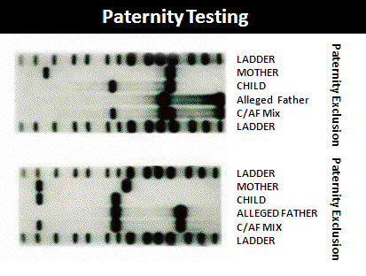
Notes:
According to the University of Utah, this genetic test based on four markers indicates that there is more than a 99 percent probability that the alleged father is the child's biological parent. Because statistical calculations prevent a 100 percent probability of paternity, most courts accept a probability of 99.5 percent or greater as evidence of paternity. An "exclusion" result, where the patterns do not match between a child and the alleged father, is unequivocal evidence of non-paternity. Remind students that genetic tests can only absolutely disprove, not prove, relationship.

Slide 21
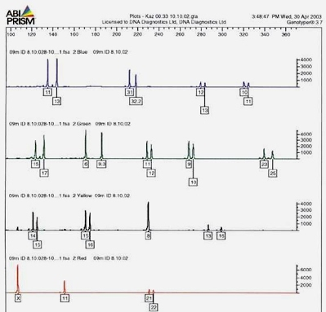
DNA on Trial
Video clip - How Innocent Man's DNA was found at Murder Scene
When medical personnel who do the testing appear at a trial, they tell the jury the statistical probability that two matching samples (one from the crime scene and one from the suspect) came from the same person.
Notes:
An STR profile of an individual is shown. Note two peaks at most of the loci tested. (This STR profile exceeds the 13 recommended by the FBI and includes additional loci used by international law enforcement agencies.) The peaks indicate the individual has heterozygous alleles at a loci. (One peak = homozygous alleles.) Also, note that each allele has a boxed number below it; these are the number of short tandem repeats (for the base sequence GATA) at each loci.

Slide 22
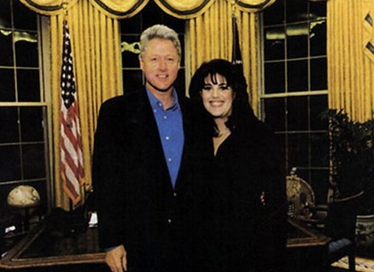
DNA on Trial
This process was used on Monica Lewinsky’s dress to indicate that there was semen from Bill Clinton. Seven base pair sequences were used and the probability of someone else having the same pattern was 1 in 8 trillion!

